Slide 1
VOC Systems
Thyanna Voisine
Dylan Schultz
Jeff Clark
Charlie Durand

Slide 2
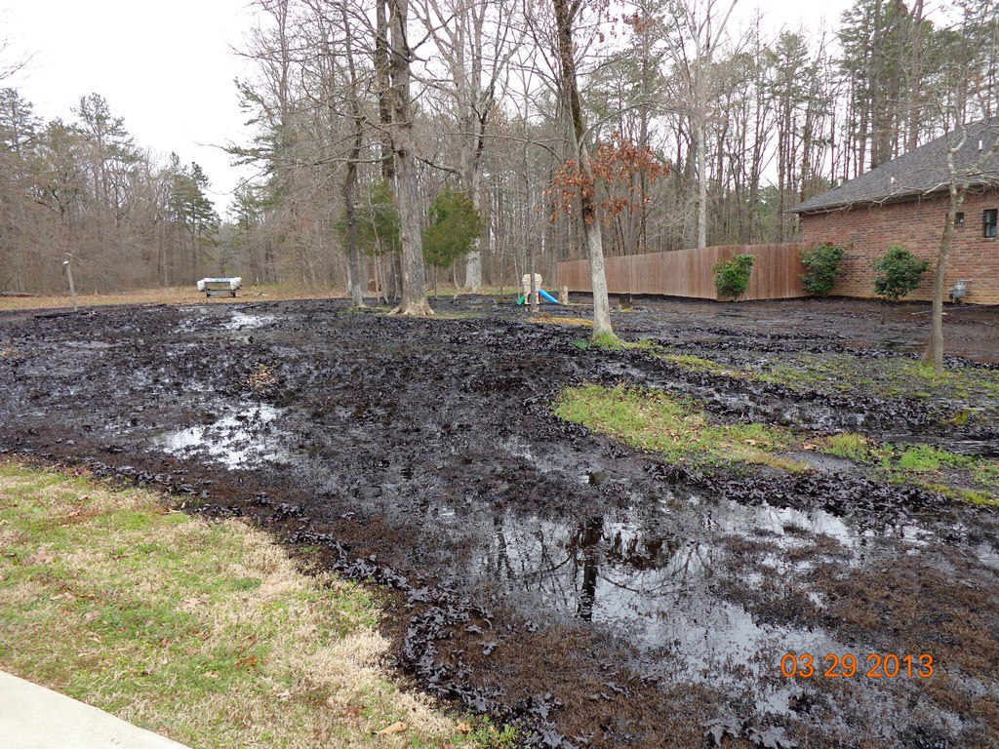
Problem

Slide 3
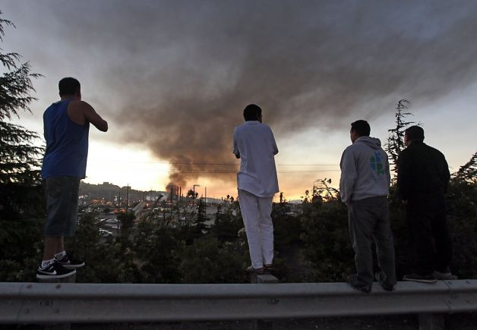

Slide 4
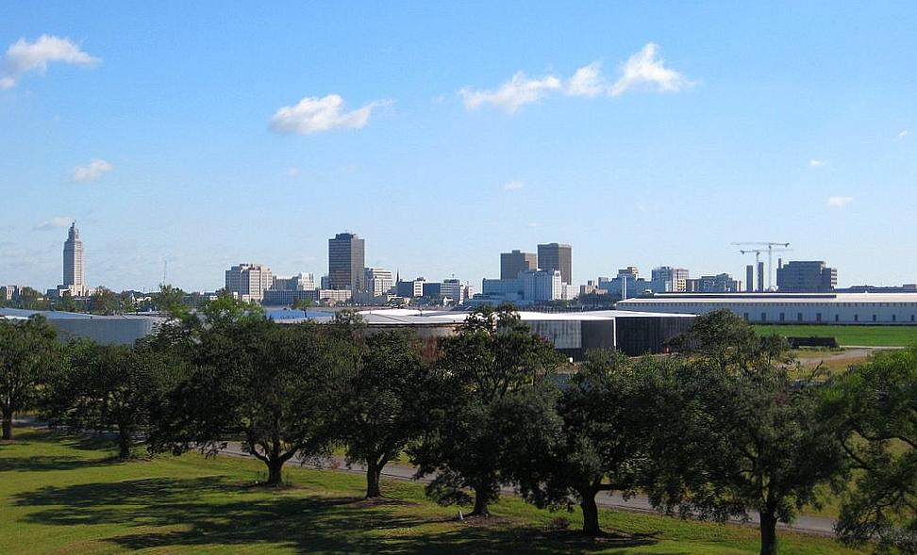

Slide 5
Solution

Slide 6

Market

Slide 7

CBE uses a full range of tactics to fight for environmental justice—and legal work is central. CBE’s legal team fights for better air quality, clean energy, smarter land use and transportation, and climate justice.

Slide 8

Competition

Slide 9

Financial Plan

Slide 10

Forecast

Slide 11
Invest in VOC Systems

